Slide 2
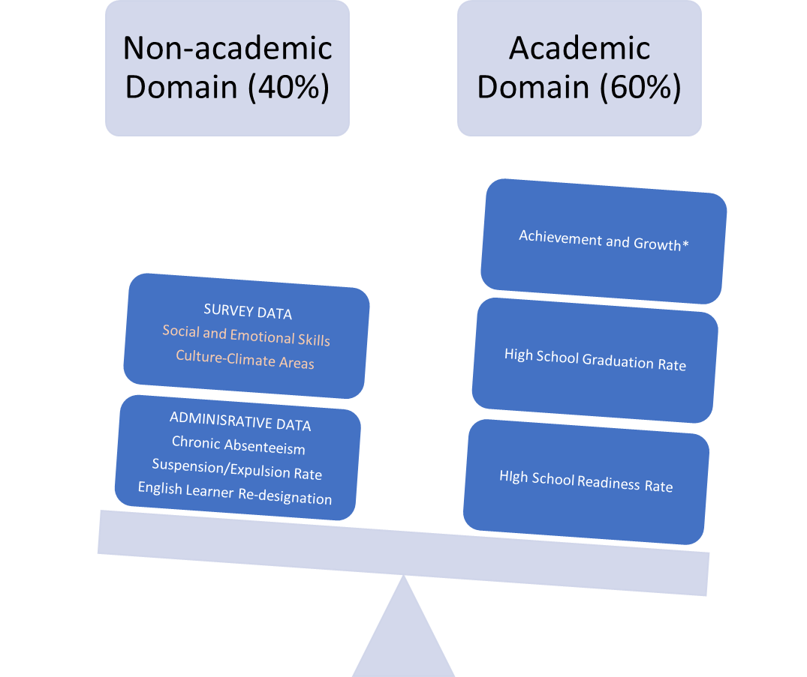
Elements featured in school report cards under CORE Districts’ School Quality Improvement Index (SQII)

Slide 3
What do the CORE surveys measure on social and emotional learning?
 | Competency/Skill | Definition
Social and Emotional | Growth Mindset | The belief that one’s abilities can grow with effort. Students with a growth mindset see effort as necessary for success, embrace challenges, learn from criticism, and persist in the face of setbacks.
 | Self-Efficacy | The belief in one’s own ability to succeed in achieving an outcome or reaching a goal. Self-efficacy reflects confidence in the ability to exert control over one’s own motivation, behavior, and environment.
 | Self-Management | The ability to regulate one’s emotions, thoughts, and behaviors effectively in different situations. This includes managing stress, delaying gratification, motivating oneself, and setting and working toward personal and academic goals.
 | Social Awareness | The ability to take the perspective of and empathize with others from diverse backgrounds and cultures, to understand social and ethical norms for behavior, and to recognize family, school, and community resources and supports.

Slide 4
What do the CORE surveys that use to measure school culture and climate?
 | Competency/Skill | Definition
Climate and Culture | Climate of Support for Academic Learning | Students and teachers feel that there is a climate conducive to learning and that teachers use supportive practices, such as: encouragement and constructive feedback; varied opportunities to demonstrate knowledge and skills; support for risk‐taking and independent thinking; atmosphere conducive to dialog and questioning; academic challenge; and individual attention to support differentiated learning.
 | Sense of Belonging | School Connectedness A positive sense of being accepted, valued, and included, by others (teacher and peers) in all school settings. Students and parents report feeling welcome at the school.
 | Knowledge and Fairness of Discipline Rules and Norms | Clearly communicated rules and expectations about student and adult behavior, especially regarding physical violence, verbal abuse or harassment, and teasing; clear and consistent enforcement and norms for adult intervention
 | Sense of Safety | Students and adults report feeling safe from verbal abuse, teasing, or exclusion by others in the school.

Slide 5
2016-17 Culture and Climate Results

Slide 6
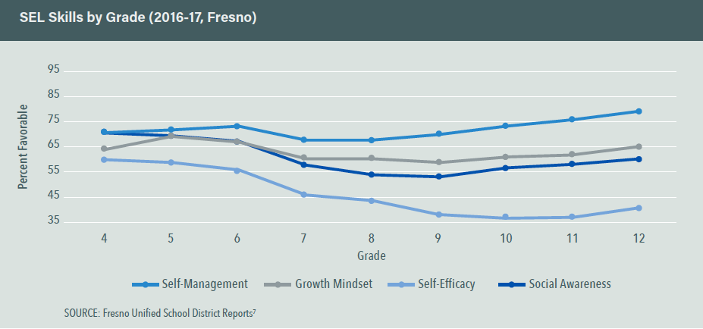
Social and Emotional Skills by Grade

Slide 7
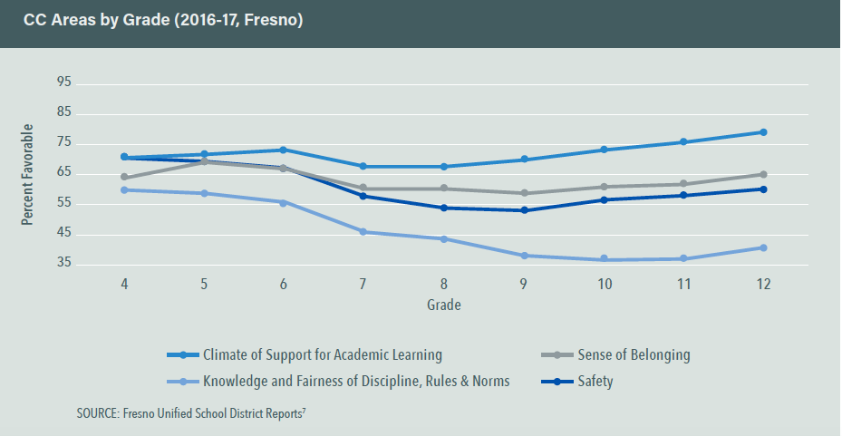
Culture and Climate Areas by Grade

Slide 8
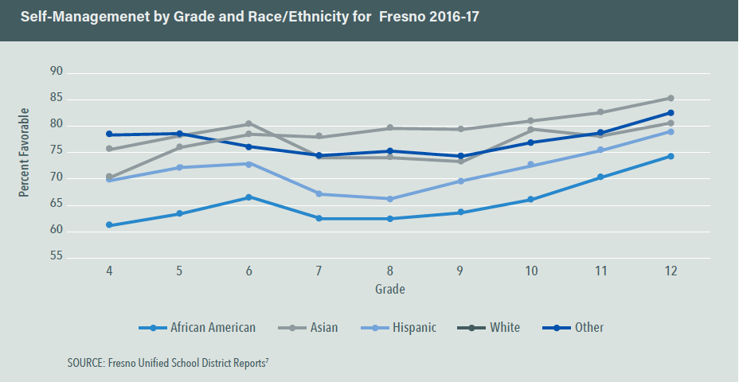
Self-Management by Grade and Race/Ethnicity

Slide 9
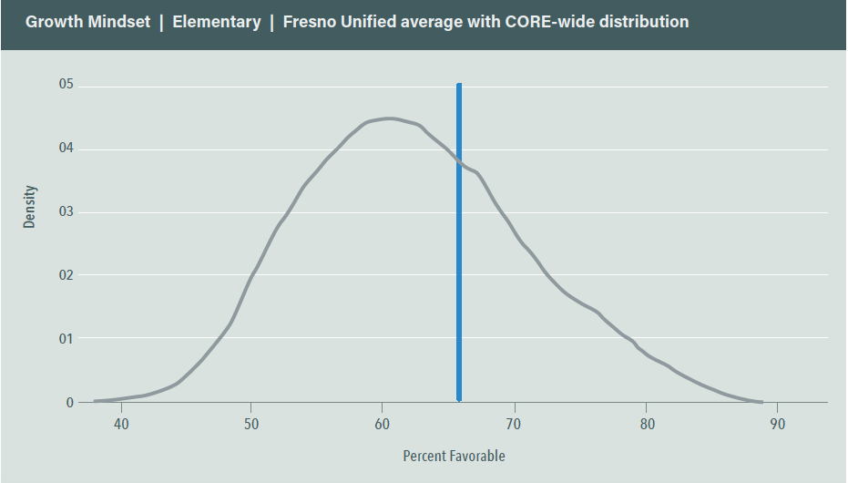
Fresno Compared to CORE Districts: Growth Mindset in Elementary School
(Elementary = grades 4-6; Secondary = Grades 7-12)

Slide 10
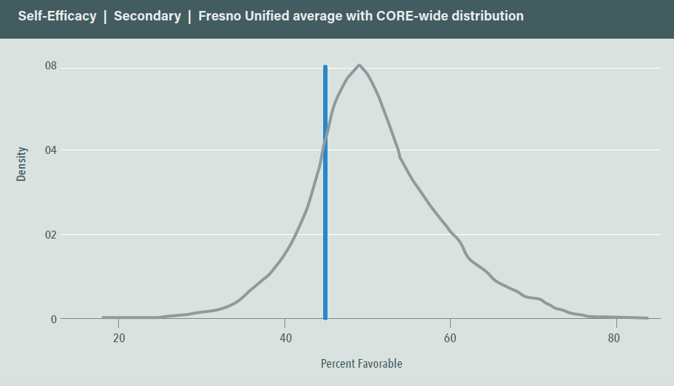
Fresno Compared to CORE Districts: Self Efficacy in Secondary Schools

